Slide 1
Communication with Co-workers
Digidentity Assignment

Slide 2
Reporting within Team
Test team member (the discoverer) finds a bug and reaches out to development team member
Communication can either be F2F or over call based on project/Team setup
If bug fix is going to take longer duration then raise a defect in Defect management tool(JIRA/HP ALM/QC) and track it, follow it up until it get fixed with timely reminders
Keep a track of it in necessary status meeting Eg: Daily Stand-Up
Once the issue is resolved arrange session with team to share updates(Share knowledge)

Slide 3
Reporting Outside Team
Tester raise defect in any defect tracking tool(HP ALM,JIRA, Bugzilla ..etc)
Assign the defect number to affected test case, based on severity mark it as blocker
Raise an impediment in cross team meetings Eg: Scrum of Scrums
Take up issue in scrum meeting

Slide 4
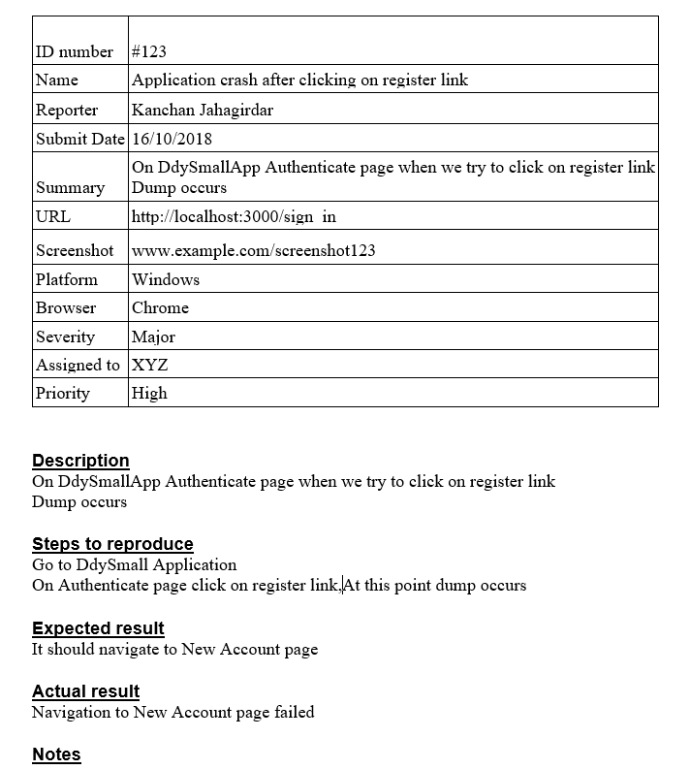
Sample Bug Report-from assignment
ID number
Issue Name
Reporter
Date
Summary
Screenshot
Platform
Severity
Assigned To
Priority

Slide 5
Characteristics of Bug report
Be clear
Reproducible
Detailed steps to reproduce the defect
Indication of the important characteristics of the defect such as severity, priority, type & so on
Illustrations or videos of the defect in the addition

Slide 6
THANK YOU
Digidentity Assignment

